Slide 1

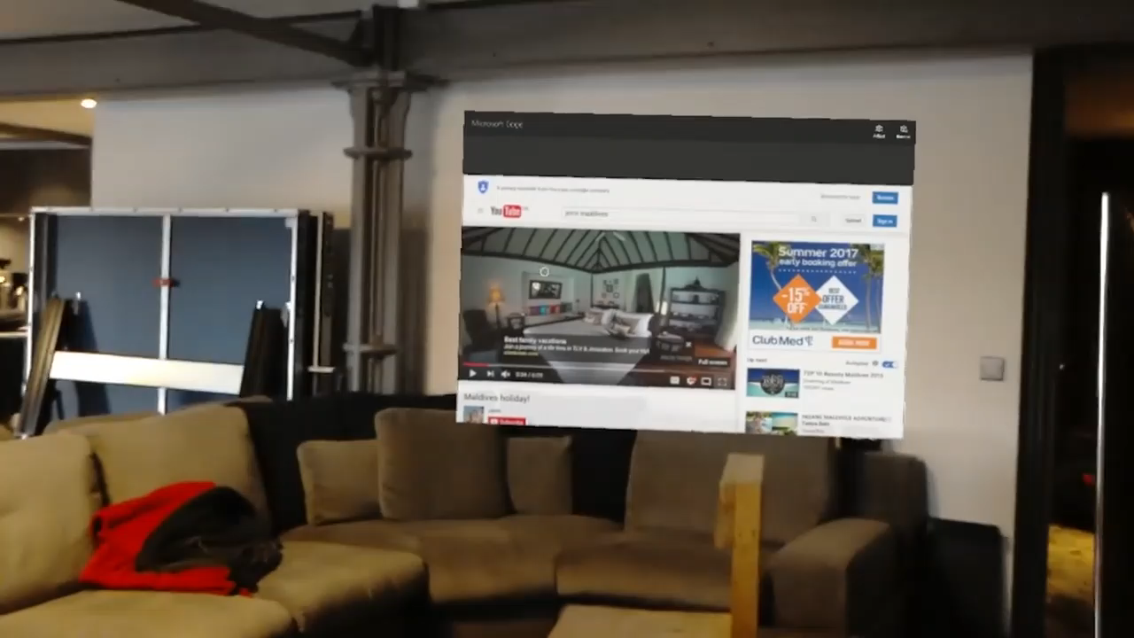
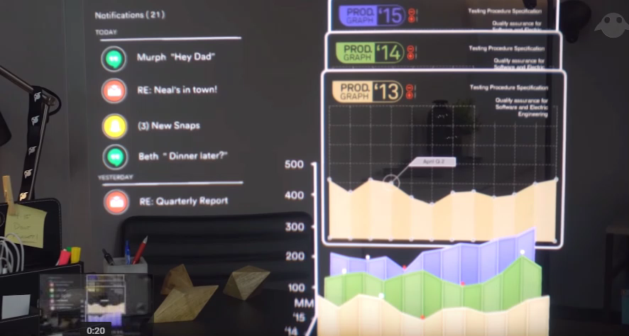
HOW MIXED REALITY MAKES LIFE EASY..
Mixed reality can really help humanity in preserving electricity and also save a lot of money in general. The innovative MR products these days, allow people to do many sorts of things like watch tv, mailing , messaging, immersive shopping, etc. which essentially means that we don’t have to spend any more money on buying TV’s or Laptops, also can have a quite immersive shopping experience thereby saving a lot of time and money
However, MR has its difficulties too, the technology in MR used these days cannot completely provide a good and immersive experience as an original TV or laptop would do. Whether it’s poor resolution, inaccurate computer vision, or uncomfortable human/computer interactions, the actual experience never lives up to what it’s supposed to be. But we can hope that this issue shall be resolved in the near future for sure.

